Slide 1
Faithful Witness
Podcast Series
2020

Slide 2
Zooming in: Messenger Zooming out: Message
Messenger
Message
Notes:
Describe what ways honor-shame communities are different from a standard Christian setting?
1. Messenger: the messenger has to be credible by markers of credibility recognizable by the host community. What I mean is that not wearing jewelry or being vegetarian does not say much about my faith because those are not traits of purity that Honor-Shame people value. Honor-Shame people have a different operating system. That which is good for us is always better than that which is good for me. So communal prayers will always be superior to private prayers. Generosity, bravery, hospitality, and modesty are ranked higher than having pure thoughts or being very studious of the Bible at home. Now, purity ranks very high, especially for women but is a purity that serves to cleanse one's social surroundings, not just a personal sense of well-being.
2. Message. We claim to bring Good News, but we need to ask, Good News for who? And this requires careful theologizing. The default way of doing things is dressing up the very ideas we learned back at home in our churches, a message which often goes this way... We offer salvation. Because of the death of Jesus at the cross, God paid the debt of sin, so now we are free. This way of communicating Good News is problematic on several fronts; 1) What does it mean that God paid anything? To whom did he pay? Who can make payment claims on God? It makes no sense. 2) Death of Jesus as God's means to remove sin is not a natural idea; it needs to be taught. If I say, "God is powerful, and he forgives," most people understand that without any more explanation. Yet, that is not at the same level as saying, "there is no remission of sin without blood." which requires explanation. 3) Freedom sound like anarchy, do what you want, which is the enemy of community. Who wants freedom? Selfish people, clean people want to be pure. So, we need to take time to hear what they hear instead of pushing what is good news for us.
Good News is that God has sent down a path to remove shame and bestow his honor. Dishonorable people like Zacchaeus, when they came in contact with Jesus, experienced a reversal of status. God was pleased with them and had a way to deal with sin; saying yes to Jesus meant generosity towards the community, mercy, and desire to seek restoration. The obedience that comes from faith and confidence, not shame.
Good News brings social order, which is highly valued, not just right personal standing before God.

Slide 3
Purpose of Faithful Witness Series
HOW?
Road Map for navigating …
culture,
faith in God,
witnessing,
living as God’s end time
Notes:
2. Now, we are taking a step forward and would like to cover how discipleship works in an honor-shame society. More precisely, how a person's faith develops, how their worldview changes. Gaby, how would you state the purpose of this series?
Discipleship is about yeast; putting the yeast of the Gospel into different types of doughs and seeing it permeate every area of life: family, finances, entertainment, food, friends, you name it. Yeast is yeast, but if the batch of dough is for a recipe for French bread, baguette, it will look different from Indian naan bread or Greek Pita bread. You may say, well, this is very basic, but actually is not. Learning to recognize yeast in every type of bread is critical for not importing our bread recipe and encountering resistance. This series is about yeast, Gospel yeast, not which kind of bread recipe is the best. We want to clarify what is Kingdom yeast, and how we knead it into any dough. The proof that healthy yeast is at work is the quality of disciples that emerge, people whose characters are being reshaped under the divine potter's finger.
Many of us are working cross-culturally. How do we minister the yeast of the Kingdom? The title Faithful witness captures de intent of presenting a progressive and field tested path for discipleship that may serve as a sort of road map to navigate, culture, faith, witnessing, and living as God’s end time among the nations.

Slide 4
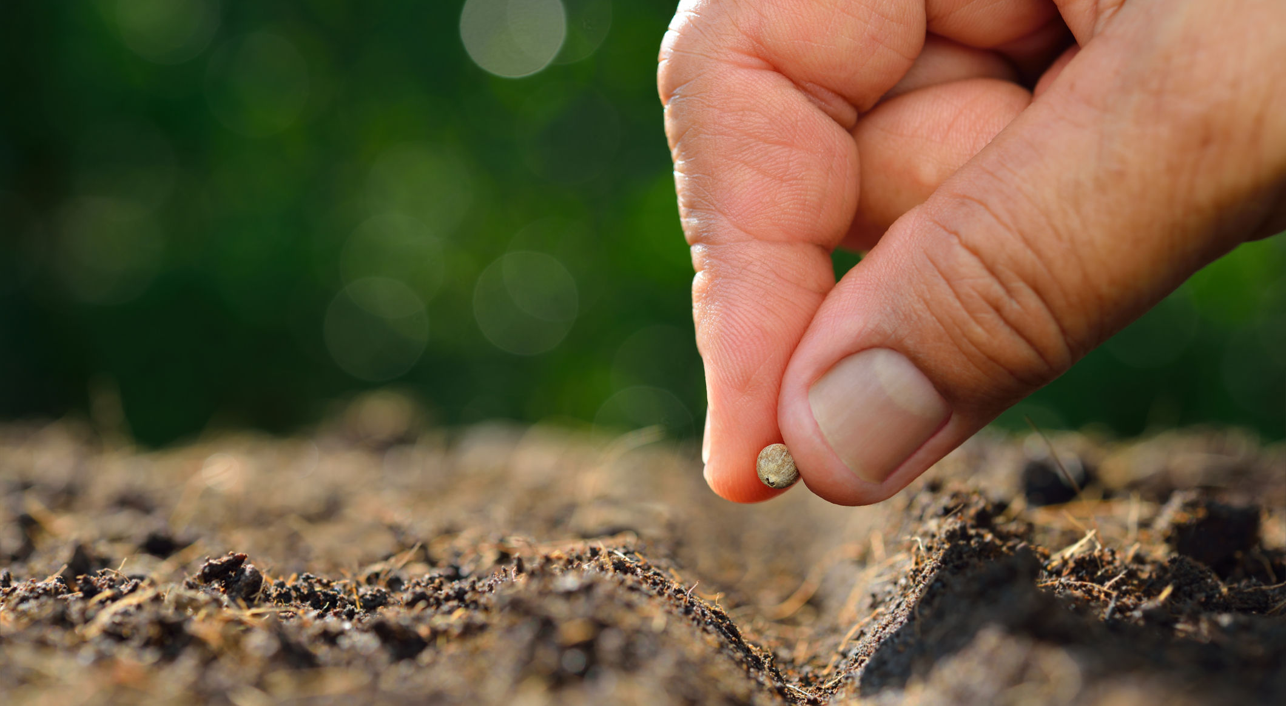
God’s Job Description: Mission Shalom
Him: God’s exclusive role
Us: Partnership with God
Notes:
Conversion and worldview change toward a biblically-shaped worldview is God's exclusive work. How can we be part of this work? — God's invitation to partner
In any job description, you need to know what is expected from you and what is the role of someone else; otherwise, you may get into trouble. What is God's exclusive work, and what is he inviting us to partner with Him. Blurring these two can lead to frustration and failure. God brings growth. Think of a plant; I can put the seed on the soil, pour water, and care for the soil. I cannot make it grow. I cannot make it bear fruits. I cannot change an apple tree into a fig tree, no matter how much I pray, fast, or study the Bible. I cannot bring conviction of sin, God Spirit does, but I can point to the data, the biblical evidence. I can tell stories from the Bible or their sacred scriptures that reveal how God does not take sin lightly, or I can pray for God to convict someone. Understanding what my role is and what I God's is very liberating. We need to bring a faithful witness through our lives and Scriptures, the rest of the process belongs to God, and we can relax.

Slide 5
Adventist Lens
Great Controversy:
Character,
Law
Government of God
Identity rooted in our eschatology
Sabbath: contested loyalty
End time warning & Hope
Notes:
Gaby, not only the cross-cultural and cross-religious discipleship that we want to teach here should be sound from a Christian perspective, but it should also have a deeply Adventist ethos. How does the model for faith development and worldview change that you will be presenting in this series have this distinctly Adventist perspective?
This is a critical question, and I appreciate you asking it. Adventism has its own frame for explaining about the big questions of life and the small ones too. We call that frame the Great Controversy, which has incredible explanatory power. We have a particular focus on clarifying the issues related to God's character, how he governs without the use of force, and his law, which leads to a wise life. Adventism has a particular understanding of how the final chapter of this earth history wraps up and how that affects our identity, mission, and message/ final warning.
In this series, we will explore how this frame calls for inviting people to be part of God's last day movement a movement that calls to stand faithful amidst "Babylon" and expose the many ways in which Satan is trying to usurp the place of God, his law and mars his character. The Sabbath stands as a test of loyalty and blessing for those who find shelter under God's offer of rest.

Slide 6
Under Construction
12 Sessions: based on stories, and lessons learned
Guest speakers
Bring your building blocks
The roadmap is not the road, keep your heart open!
Notes:
6. How are the episodes in this series are going to be organized? What are we to expect? We will be answering three questions. Years ago we moved to Central Asia, I had a bunch of disjointed ideas about God, church, culture, witnessing but no clue how to connect them or where to start, or how to move to the next level and so forth. I knew that God expected me to grow in faith, but how could I know if I was actually moving somewhere. You know, we Adventist read a lot, but knowledge and wisdom are not the same. So, this series was born out of my own frustration, trying to go back in time and say to myself, here you go, a sort of basic road map. So we are planning 12 session, two per stage and we will plow over actual stories, we will look at challenges and will love to hear from you what are the areas that you are struggling with, that we may see if we have resources to offer. Since this in equipping session, in some cases we will invite people who have experience in some of the areas to show you what they do, and the lessons they are learning as they go.
Please interact with us, help us to make this series a tool for you and others after you, send us your stories, lessons learned, questions or even those things that you disagree. I want to finish with a promise, Jesus will be with us, to the end. It is his power that brings change, and that is guaranteed, therefore lets’ join him in disciplemaking and be renewed in the process.

